Slide 1



Institute for Advanced Computing & Software Development
Presentation On
“Facial Expression-Based Confidence Level Estimator using Convolutional Neural Networks”
PG-DBDA - SEPT 2022
Project By :
- Shubham Gomase - 209311
- Shyam Khamkar - 209345

Slide 2


Introduction
Abstract :
Confidence is a crucial factor that affects an individual's decision-making, communication, and overall success. However, assessing confidence levels accurately can be challenging, as it is often subjective and varies from person to person. Traditional methods of measuring confidence, such as self-reported surveys, may not provide accurate results due to social desirability biases and other factors. Therefore, there is a need for a reliable and objective method of estimating confidence levels.
Problem Statement :
The ability to assess the confidence level of an individual based on their facial expressions can have significant implications in various fields, such as psychology, education, and job performance evaluation.However, accurately predicting the confidence level based on facial expressions is a challenging task that requires sophisticated techniques. In this project, we aim to develop a facial expression-based confidence level estimator using convolutional neural networks (CNNs).
Project scope :
The system will be able to detect confidence level based on facial expression of a person. It will distinguish level as low, average, high. User will upload image through upload button on website which will be deployed on cloud and confidence level of an image will displayed on website along with image. The system will be implemented using the Keras deep learning library and will use transfer learning to leverage pre-trained convolutional neural network architectures, such as VGG19, to improve performance.

Slide 3



Aim and objective:
The aim of this project is to develop a facial expression-based confidence level estimator that can accurately detect facial expressions and estimate the model's level of confidence in its predictions.
This can be useful to get confidence level of a person/candidate while exams/ interviews/ other preparations.
The objectives are to train a convolutional neural network on a dataset of labeled facial expressions, incorporate data augmentation techniques to prevent over fitting, optimize hyper parameters to achieve the best possible performance, and evaluate the model's performance using appropriate metrics. Project will be deployed on cloud as a website for user interaction. The system will have practical applications in areas such as to recruitment process, education etc.

Slide 4

Below points represents the Workflow
of this project
1
2
3
Data Gathering :
- Project Data has been taken from
Kaggle.com
- Link : https://www.kaggle.com/datasets/sougatganguly/confident-unconfident
Studying the Data :
- This data contains 2 types of images of peoples i.e Confident and Unconfident.
- This dataset contains images of old people,young peoples & kids from different Regions.
- Dataset contains 30372 images from both classes.
Data Cleaning :
- This dataset had currupted , & unwanted images in both classes which are processed and cleansed with the help of
MTCNN (Multi-Task Cascaded Convolutional Neural Networks ) is a neural network which detects faces.

Slide 5

Workflow of project..
4
5
6
Data Processing :
- Actual dataset had 48 x 48 pixels size of images which has been resized to 256 x 256 pixels for
Model improvement
Better Feature Extraction
Reduce Overfitting
- Rescaling of images into 0 to 1
- Balancing of class
Model Building :
- Train/Val/Test Split - 70/20/10%
- Model is build with CNN where
3 Conv2D Layers of size 3 x 3
3 Maxpooling Layer of size 2 x 2
1 Flatten Layer (1D)
2 Dense Layers with Relu,Sigmoid
- Model accuracy improved from 74 to 81% by using VGG19 Model.
Hyper Parameter Tuning :
- Model is trained with 5 epochs with batch size 32 as overfitting observed from 6th epoch onwards.
- Default learning rate of 0.001 has been changed to 0.0001 with ADAM optimizer to avoid overfitting.
- Padding kept “same”

Slide 6
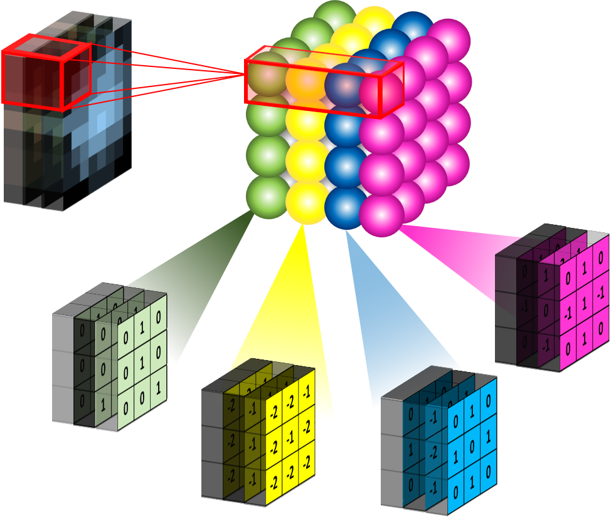
CNN (Convolutional Neural Network)
A Convolutional Neural Network (CNN) is a type of deep learning algorithm used primarily for image recognition and processing tasks.
A typical CNN consists of
Convolutional layers
Activation functions
Pooling layers
Fully connected layers
Fully connected layers

Slide 7


Consider learning an image:
Some patterns are much smaller than the whole image
Can represent a small region with fewer parameters
“Eye-brow” detected

Slide 8


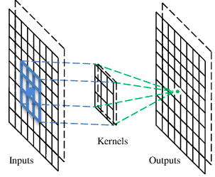
Convolutional layers
A CNN is a neural network with some convolutional layers
(and some other layers). A convolutional layer has a number
of filters that does convolutional operation.
Eye-Brow detected

Slide 9

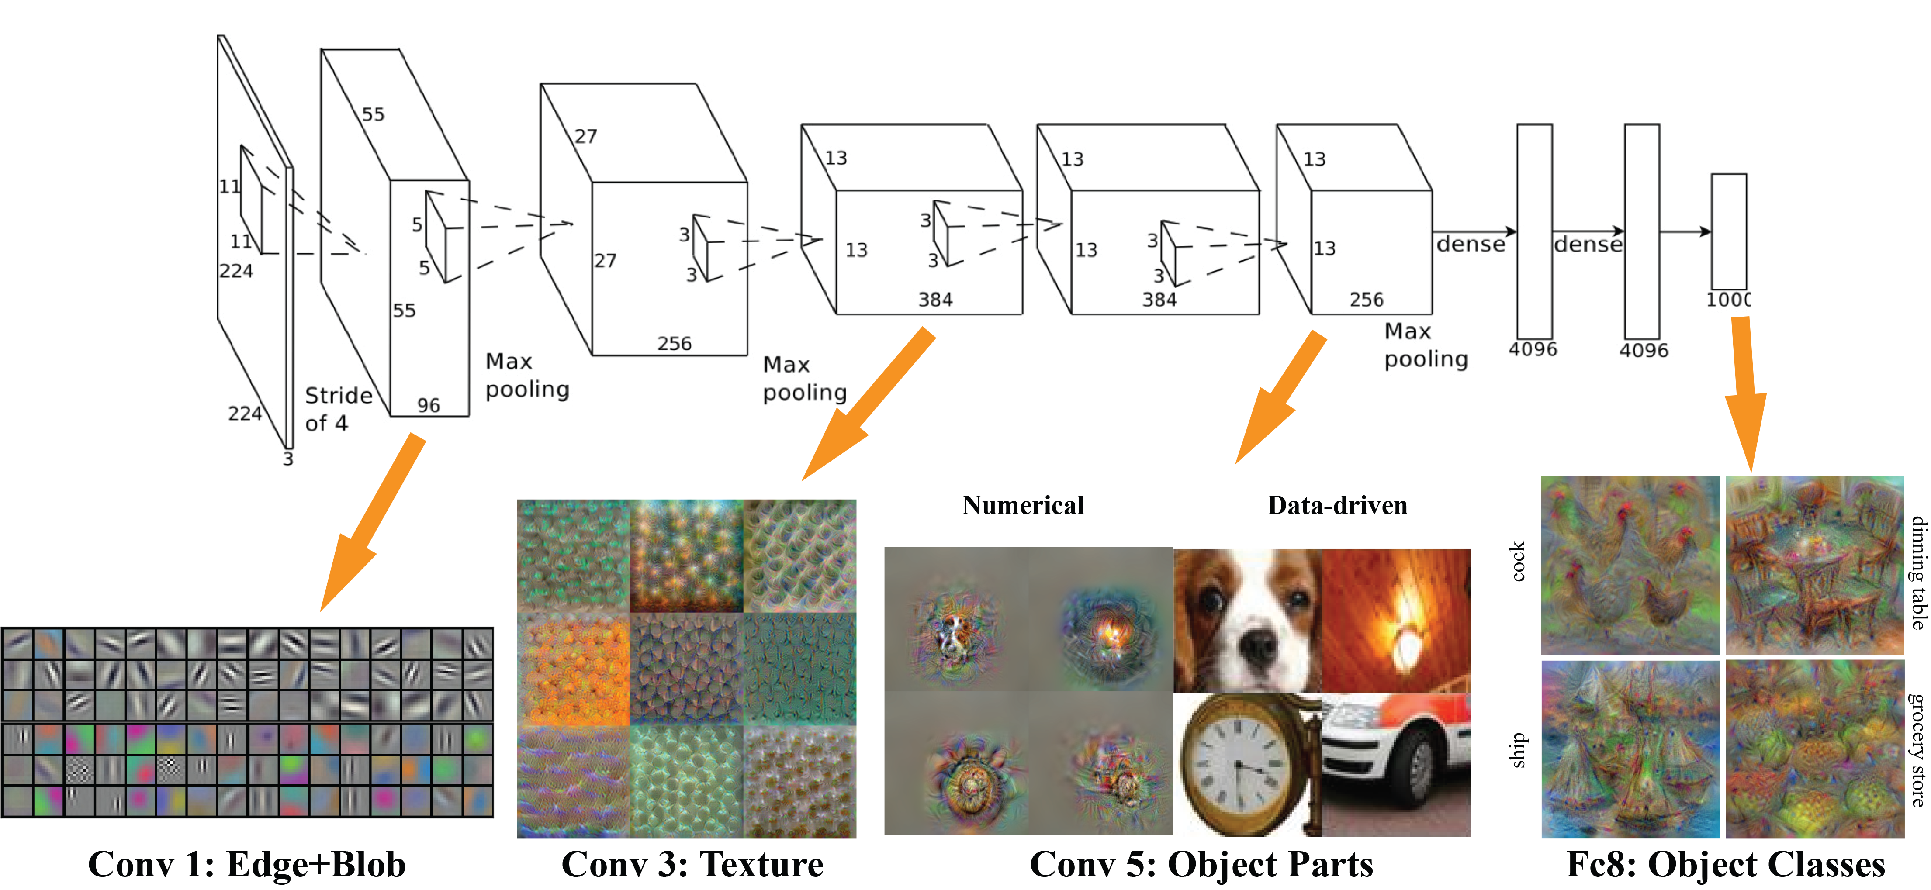
"
CNN
Multiple Conv layers output visuals

Slide 10
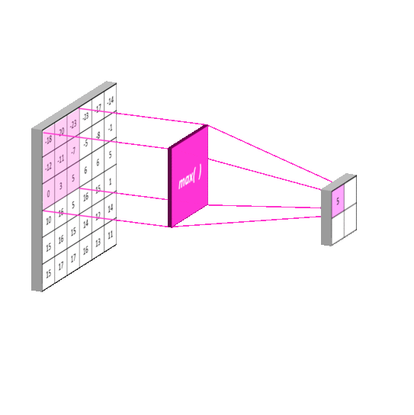
Maxpooling Layer
The Maxpooling layer in a Convolutional Neural Network downsamples the input feature map by taking the maximum value in each local pooling region.

Slide 11

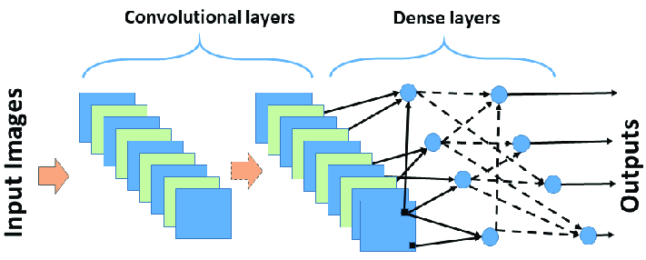
Dense Layer
The Dense layer in a Convolutional Neural Network is a fully connected layer that takes the output of the preceding convolutional layers and applies a set of neurons to perform the final classification or regression task.

Slide 12


The whole CNN :
O/p = Confident or Unconfident
Convolution
Max Pooling
Can repeat many times
Fully Connected network
Convolution
Max Pooling
Flattened

Slide 13

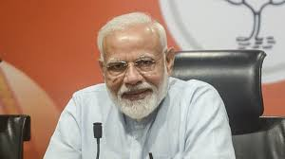
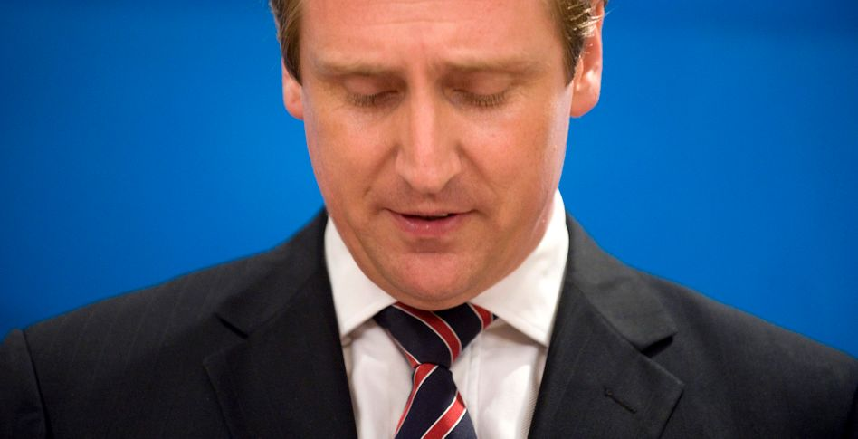
Inside Neural Network...
Confident

Slide 14
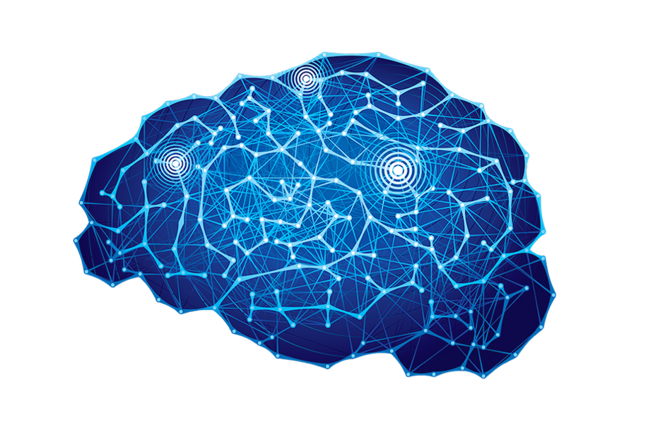
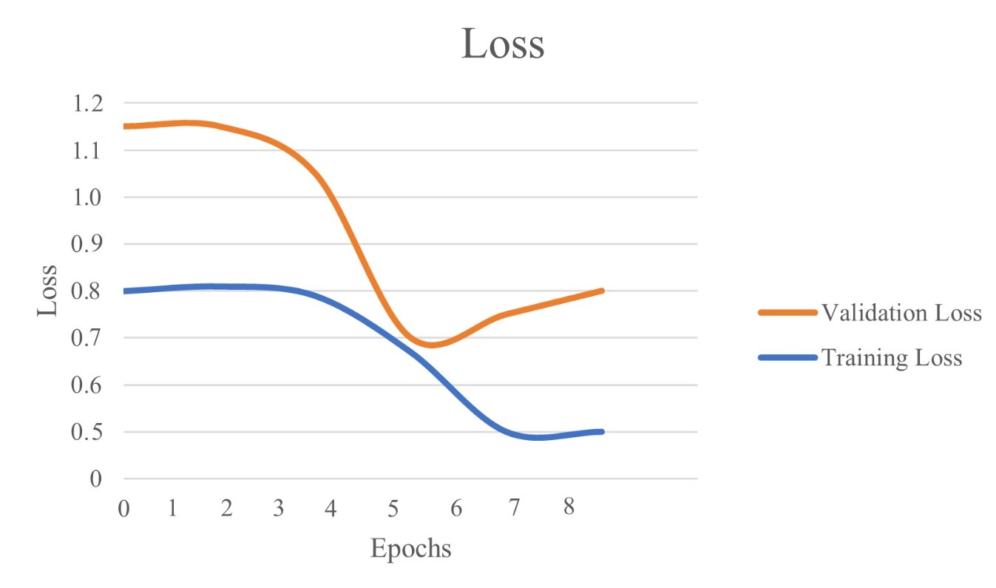
Epoch adjustment over val
loss ...

Slide 15
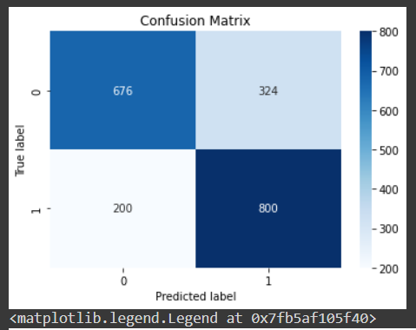
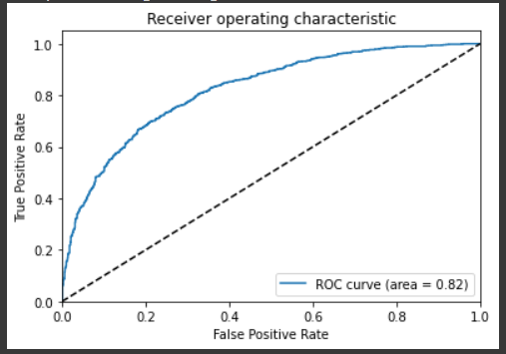
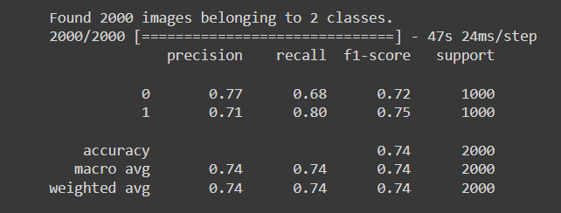
Outputs achieved with our model..
Evaluation Matrix
Confusion Matrix
ROC Curve
We compared this Model with VGG19 model performance ...

Slide 16

How can we improve model performance ??? Lets try VGG19

Slide 17
Improving model performance with VGG19 pretrained model :
VGG19 is a convolutional neural network architecture that was developed by the Visual Geometry Group (VGG) at the University of Oxford. It was created as part of the ImageNet Large Scale Visual Recognition Challenge (ILSVRC) in 2014, and has achieved state-of-the-art results in image classification tasks.
The network consists of 19 layers, including 16 convolutional layers and 3 fully connected layers. Each convolutional layer is followed by a rectified linear unit (ReLU) activation function, and each pooling layer uses max pooling. The network also uses dropout regularization to prevent overfitting.
VGG19 is trained on the ImageNet dataset, which consists of over 1 million images across 1000 different classes. The network is able to classify images with high accuracy, and is often used as a benchmark for other image classification tasks.
One of the key features of VGG19 is its deep architecture, which allows it to learn complex features from images.

Slide 18
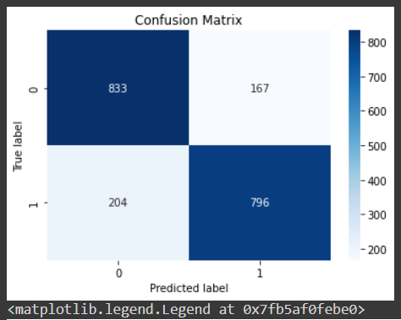
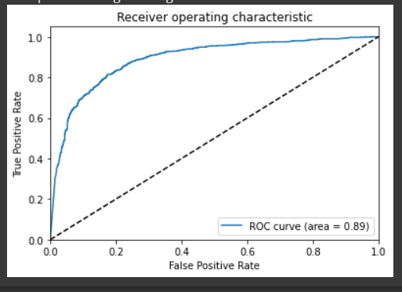
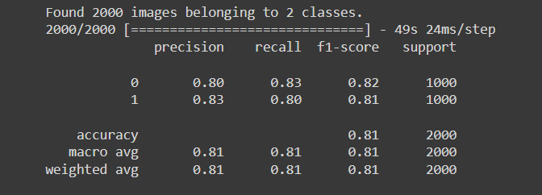
Outputs achieved with VGG19 model..
Evaluation Matrix
Confusion Matrix
ROC Curve
Accuracy Improved from 74 to 81 %

Slide 19



References :
1) Wang, Weiqing, et al. "Emotion recognition of students
based on facial expressions in online education based on the
perspective of computer simulation." Complexity 2020
(2020).
2) Minaee, Shervin, Mehdi Minaei, and Amirali Abdolrashidi.
"Deep-emotion: Facial expression recognition using
attentional convolutional network." Sensors 21.9 (2021):
3046.
3) Mahmood, Awais, et al. "Recognition of facial expressions
under varying conditions using dual-feature
fusion." Mathematical Problems in Engineering 2019 (2019).
4) Ioannou, Spiros, et al. "Robust feature detection for facial
expression recognition." EURASIP Journal on Image and
Video Processing 2007 (2007):

Slide 20

Special Thanks to..
Dr. Shantanu Pathak
Mrs. Preeti Take
Mrs. Priyanka Bhoir

Slide 21

Yess !
I’am Confident
THANK YOU!

